Slide 1



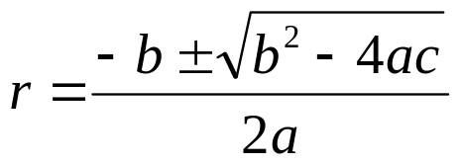

Ch 3.3:
Complex Roots of Characteristic Equation
Recall our discussion of the equation
where a, b and c are constants.
Assuming an exponential soln leads to characteristic equation:
Quadratic formula (or factoring) yields two solutions, r₁ & r₂:
If b² – 4ac < 0, then complex roots: r₁ = λ + iμ, r₂ = λ - iμ
Thus

Slide 2
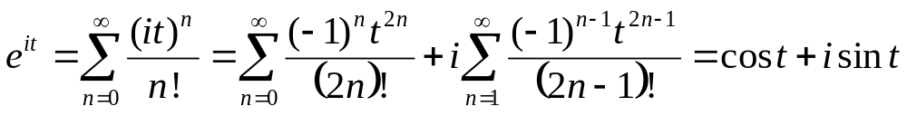

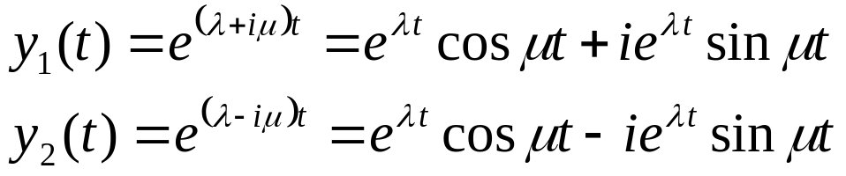
Euler’s Formula; Complex Valued Solutions
Substituting it into Taylor series for e^{t}, we obtain Euler’s formula:
Generalizing Euler’s formula, we obtain
Then
Therefore

Slide 3
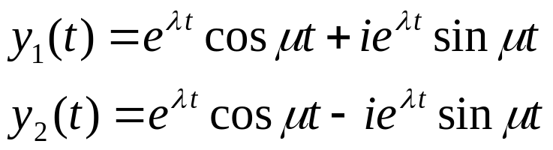
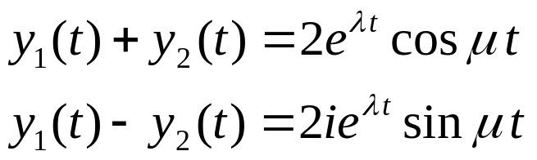

Real Valued Solutions
Our two solutions thus far are complex-valued functions:
We would prefer to have real-valued solutions, since our differential equation has real coefficients.
To achieve this, recall that linear combinations of solutions are themselves solutions:
Ignoring constants, we obtain the two solutions

Slide 4

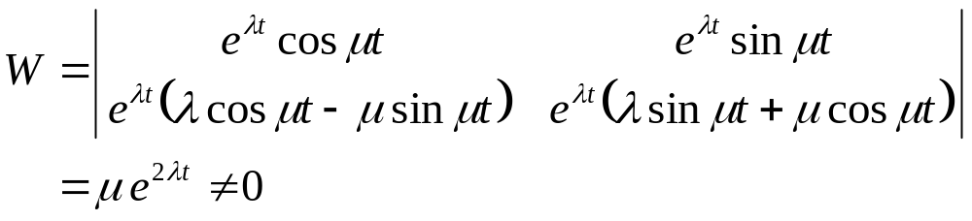

Real Valued Solutions: The Wronskian
Thus we have the following real-valued functions:
Checking the Wronskian, we obtain
Thus y₃ and y₄ form a fundamental solution set for our ODE, and the general solution can be expressed as

Slide 5


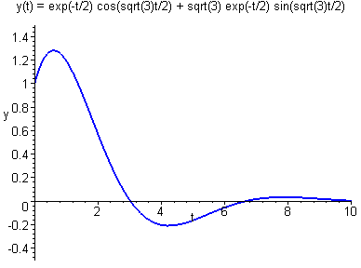
Example 1
Consider the equation
Then
Therefore
and thus the general solution is

Slide 6



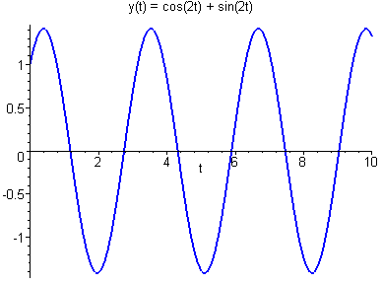

Example 2
Consider the equation
Then
Therefore
and thus the general solution is

Slide 7

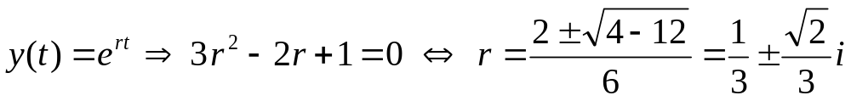
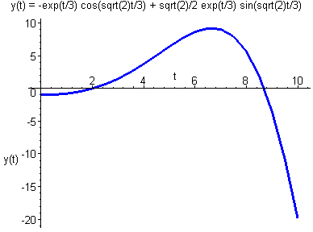
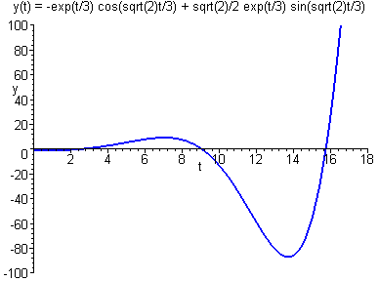
Example 3
Consider the equation
Then
Therefore the general solution is

